Slide 1
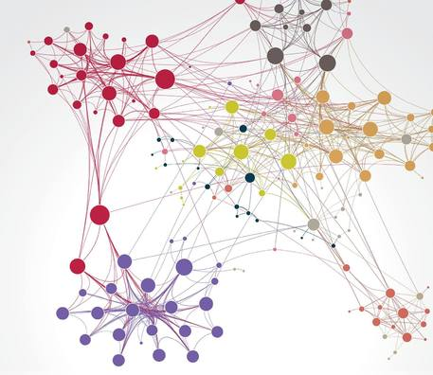
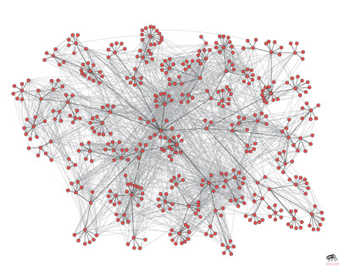
Structures of Networks
D. Watts, S. Strogatz – Collective dynamics of ‘small world‘ networks (Nature Vol. 393, 1998)
A. Barabási, R. Albert – Emergence of scaling in random networks (Science, Vol. 286, 1999)
‘When Physics meets biology’ WiSe2016/17 --- Lisa Schula

Slide 2
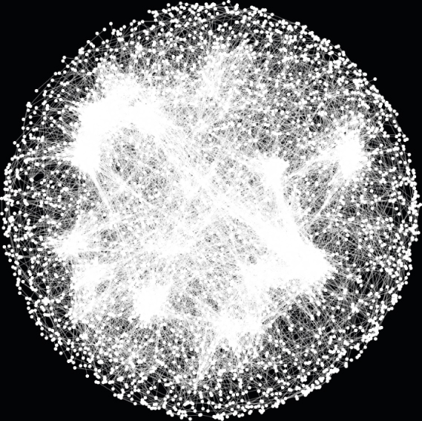
Biology:
Neural network
Metabolic network
Protein interaction network of a cell
Ref: M. Constanzo et al.
‘A global genetic interaction network maps a wiring diagram of cellular function’
Science Journal 2016

Slide 3
Structures of Networks
Graph Theory
D. Watts and S. Strogatz: ‘small world’ networks
A. Barabási and R. Albert: Scaling in random networks

Slide 4
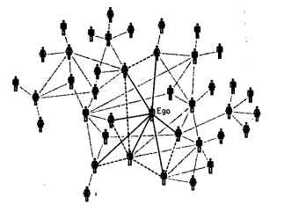
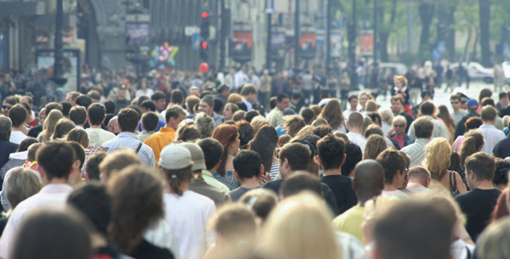
Small world experiment

Slide 5
Graph Theory
General graph (N vertices, k edges) | Random graph (N, k, p)
Degree k_{i} Average degree $\left\langle \text{k}\right\rangle$ | $\left\langle \text{k}\right\rangle$ = p(n-1)
Gauss sum
(n-1) + (n-2) + ... = n(n-1)/2

Slide 6
Graph Theory
General graph (N vertices, k edges) | Random graph (N, k, p)
Degree k_{i} Average degree $\left\langle \text{k}\right\rangle$ | $\left\langle \text{k}\right\rangle$ = p(n-1)
Degree distribution P(k) | Binomial P(k)$=\left({\text{(}\text{n}\text{−1)} \atop \text{k}}\right)$ p^{k} (1-p)^{(n-1)-k}
Poisson approximation (large N, k fixed)
P(k)$=$z^{k}e^{-z}/k!
z = $\left\langle \text{k}\right\rangle$

Slide 7
Graph Theory
General graph (N vertices, k edges) | Random graph (N, k, p)
Degree k_{i} Average degree $\left\langle \text{k}\right\rangle$ | $\left\langle \text{k}\right\rangle$ = p(n-1)
Degree distribution P(k) | P(k)$=\left({\text{(}\text{n}\text{−1)} \atop \text{k}}\right)$ p^{k} (1-p)^{(n-1)-k}
Clustering coefficient C | C = p

Slide 8
Graph Theory
General graph (N vertices, k edges) | Random graph (N, k, p)
Degree k_{i} Average degree $\left\langle \text{k}\right\rangle$ | $\left\langle \text{k}\right\rangle$ = p(n-1)
Degree distribution P(k) | P(k)$=\left({\text{(}\text{n}\text{−1)} \atop \text{k}}\right)$ p^{k} (1-p)^{(n-1)-k}
Clustering C | C = p
Shortest path length L_{ij} Average path length L | L ∝ ln(N) / ln( $\left\langle \text{k}\right\rangle$ )
Random graph versus Regular grid

Slide 9
Graph Theory
Additional features:
Directed links
More than one link between two vertices
Weighted edges
...

Slide 10
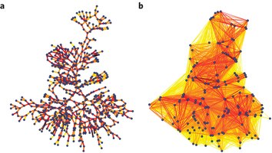
Real world networks
Ref: D. Watts & S. Strogatz – Collective dynamics of ‘small world‘ networks
→ Small average path length
→ High clustering

Slide 11
Watts-Strogatz construction
Start with two conditions:
Regular graph: k_{i} = constant
High Clustering
But on average long paths
‘large world’
→ modification
Regular ring lattice
with k = 4

Slide 12
Watts-Strogatz construction
1
Rewiring process:
change ending point of edge
with probability p
Computer simulation:
fix values N and k (very large)
one construction with fixed probability
→ Repeat with different values for p
2
3
...

Slide 13
Probability p of replacing edge
p = 0
p = 1
regular
Small world
random
large C
large L
large C
small L
small C
small L

Slide 14
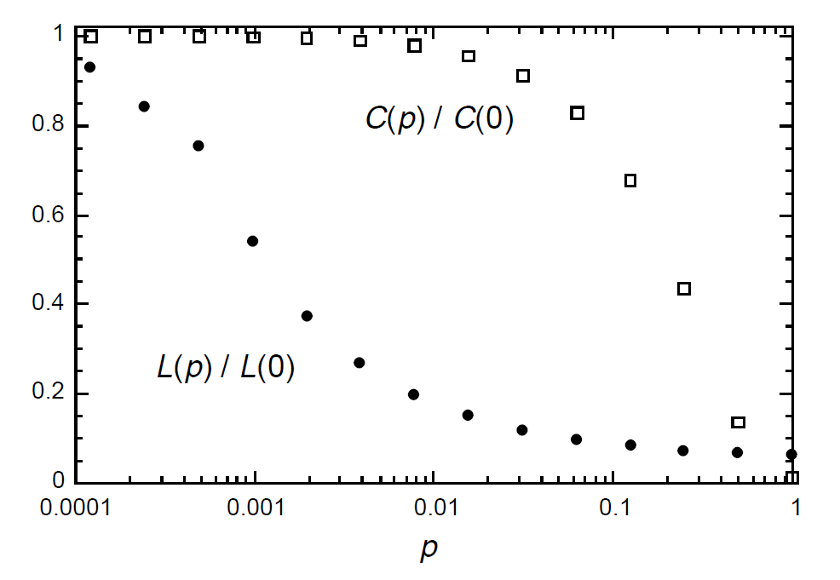
regular
Small world
Small L
Large C
random
Ref: D. Watts & S. Strogatz: Collective dynamics of ‚small world‘ networks

Slide 15
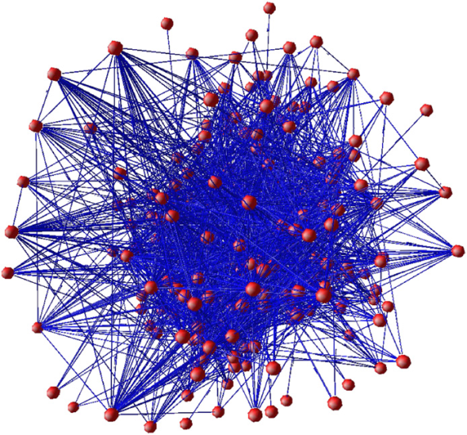
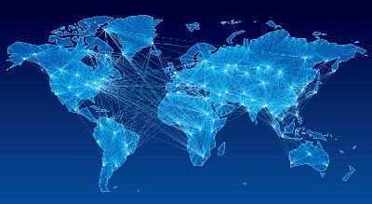
Consequence for networks
Neural Network of C. Elegans
Airline network
Ref: H. Berry, O. Temam
‘Modeling self-developing biological neural networks’
Science Direct 2007
http://airlinenetworkplanners.com

Slide 16
Degree distribution P(k)
Exponential
P(k) ∝ e ^{- k}
Power-law
P(k) ∝ k ^{- γ}
Small world model
between regular and random
Real world networks
Ref.: R. Albert, A- Barabasi, H. Jeong
‘Error and attack tolerance of complex networks’ Nature Reviews 2000,
‘Emergence of scaling in random networks’

Slide 17
Degree distribution P(k)
Real world networks:
A actor collaboration B WWW C power grid
P(k) ∝ k ^{- γ} in
Logarithmic scale !
→ degree distribution is neither random nor fitting to small world model

Slide 18
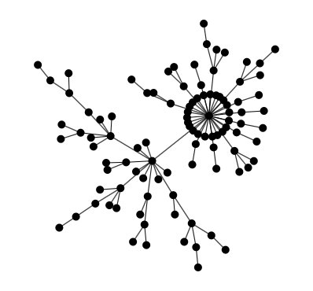
Degree distribution P(k)
Power-law
P(k) ∝ k ^{- γ}
→ presence of high degree vertices = hub
‘scale free’ distribution: f(x) → f(ax) ∝ f(x)

Slide 19
The Barabási-Albert model
Two main conditions:
(i) Buildup:
increase N and k at each step
(ii) Preferential attachment
Probability of linking depends on degree
N → N +1
k → k + m
Π($\text{k}\text{i}$) = $\frac{ \text{k}\text{i} }{Σ \text{k}\text{j}}$
1
2
3
...

Slide 20
Scale-free distribution
Computer simulation
(N₀ = 5 and m = 5, t > 100,000)
In good agreement with networks in real world
γ = 2.9
A actor collaboration γ = 2.3
B WWW γ = 2.1
C power grid data γ = 4
Ref.: A. Barabasi, R. Albert
‘Emergence of scaling in random networks’
Science Journal 1999

Slide 21
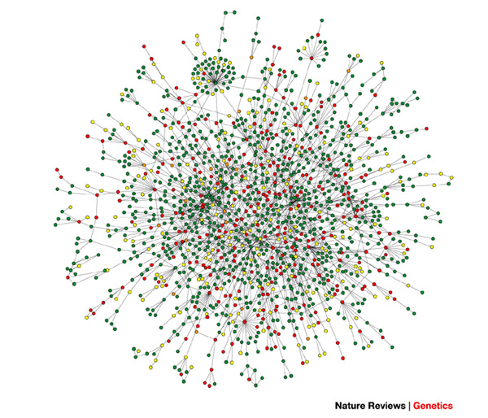
Protein interaction network of a yeast cell
Ref: M. Constanzo et al.
‘A global genetic interaction network maps
a wiring diagram of cellular function’
Science Journal 2016
A- Barabasi , Z. Oltvai
‘Network biology: understanding the cell's functional organization’ Nature Reviews Genetics 2007

Slide 22
The two models: Summary
Small world networks:
Graphs with small mean distances and high Clustering
Obtained by altering regular graph (visualisation)
Scale free graphs
Observation of hubs in networks
Distributions are scale free
Simulation yields similar distribution

Slide 23
The use of modelling
Watts-Strogatz
Few short cuts in regular system lead to ‘small world‘
Fast information exchange but also fast disease spread
Barabási-Albert
Indicate presence of hubs → learn about vulnerability
Trying to find universal laws and study evolution of networks
Networks appearing in nature are not fundamentally random

Slide 24
references
D. Watts, S. Strogatz – Collective dynamics of ‘small world‘ networks (Nature Vol. 393, 1998)
A.Barabási, R. Albert – Emergence of scaling in random networks (Science, Vol. 286, 1999)
M. Newman – Random graphs as models of networks (SFI Working Papers, 2002)
S. Wuchty, W. Ravasz, A. Barabási – The architecture of biological networks (University of Notre Dame, Indiana)

